Slide 1
The Relationship Between Netflix Usage and Daily Activity
Habibe Köseoğlu

Slide 2
This is my data science project that analyzes the relationship between my daily step counts and the time I spend watching Netflix. Using data collection and visualization techniques, I aim to uncover patterns and identify trends that can provide insights into my lifestyle.

Slide 3
Hypothesis
I started my project with the null hypothesis which is:
‘‘ There is no correlation between my netflix activity and my daily step counts.’’

Slide 4


Data Source
I retrieved my daily step counts data using the Health app in my phone. In order to get data that shows the time spend on Netflix, I demanded and downloaded my own data from Netflix.

Slide 5
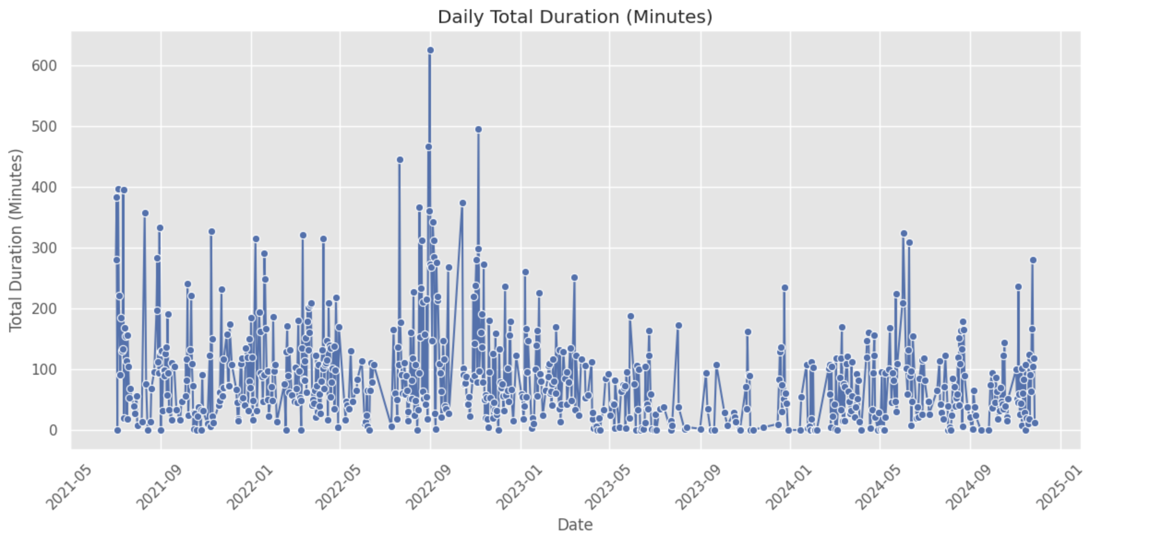
Data Analysis
For the Netflix data, first I eliminated the data of other profiles in the family account for the privacy reasons. Then I started to explore my viewing activity in minutes.

Slide 6
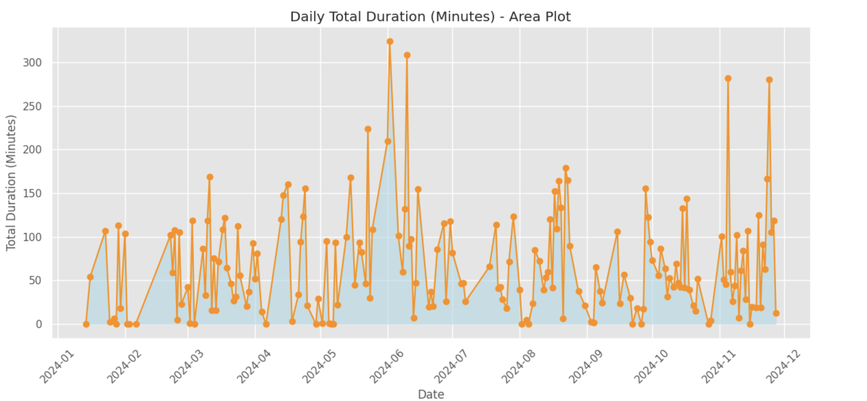
For a closer look, I wanted to focus on data of last one year.

Slide 7
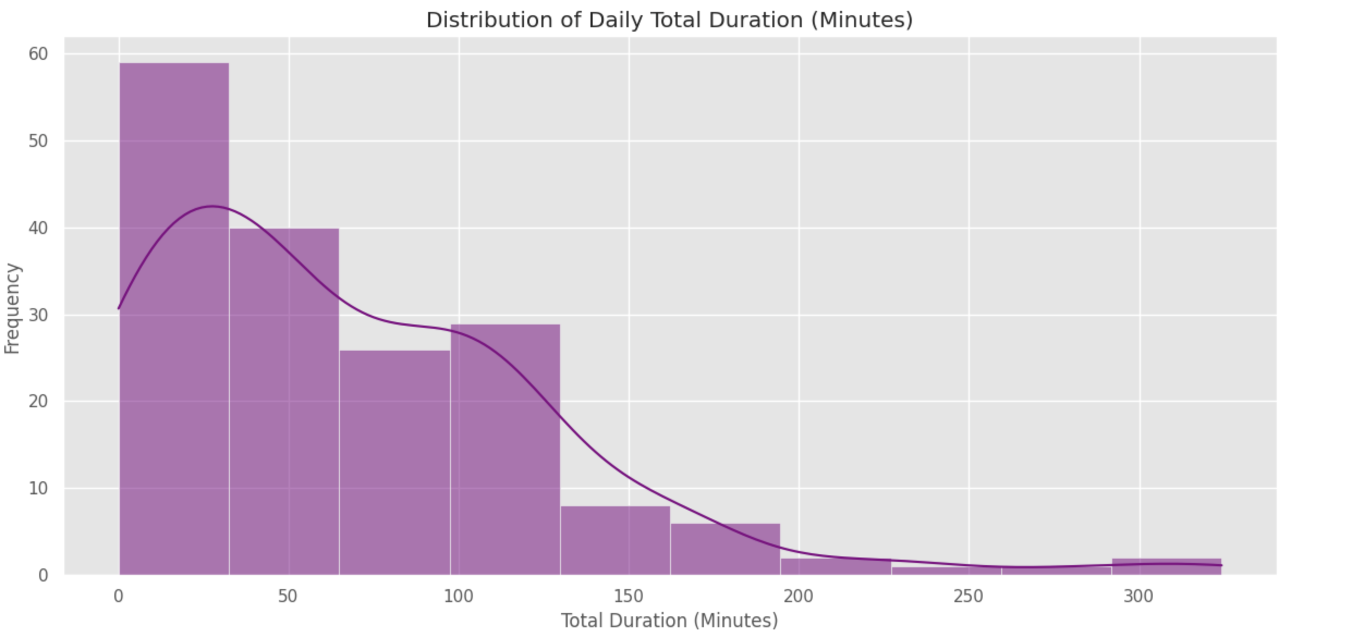
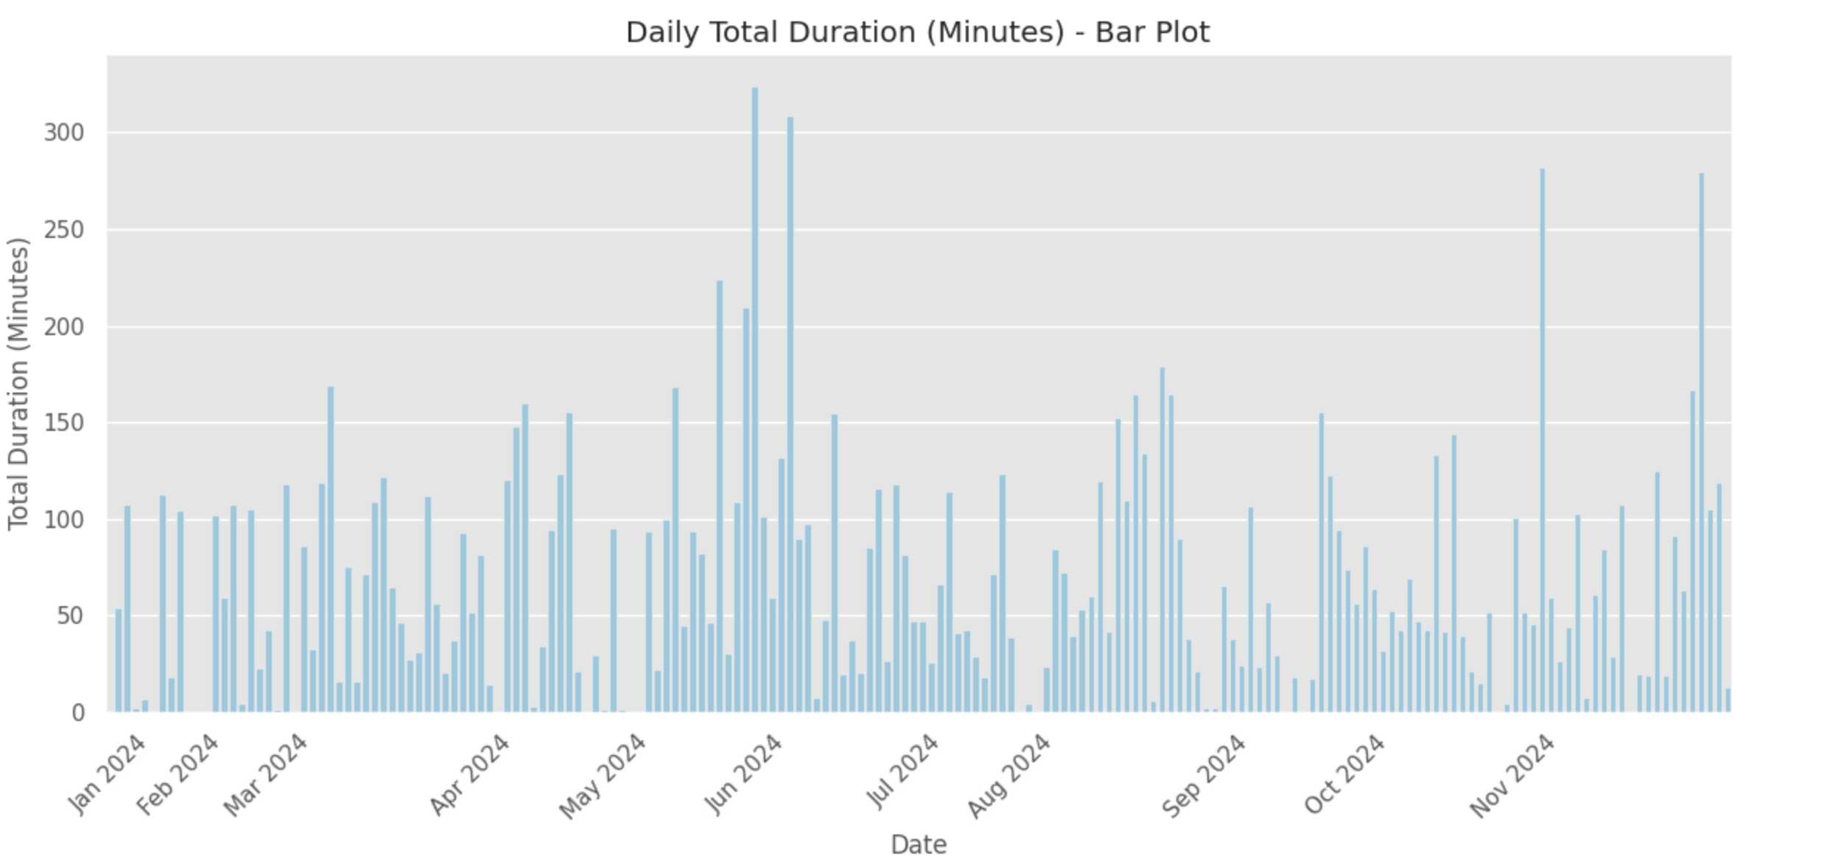
Different visualization techinues is used to analyse data.
Here we have frequency of viewing minutes.
In here we can see the bar plot version.

Slide 8
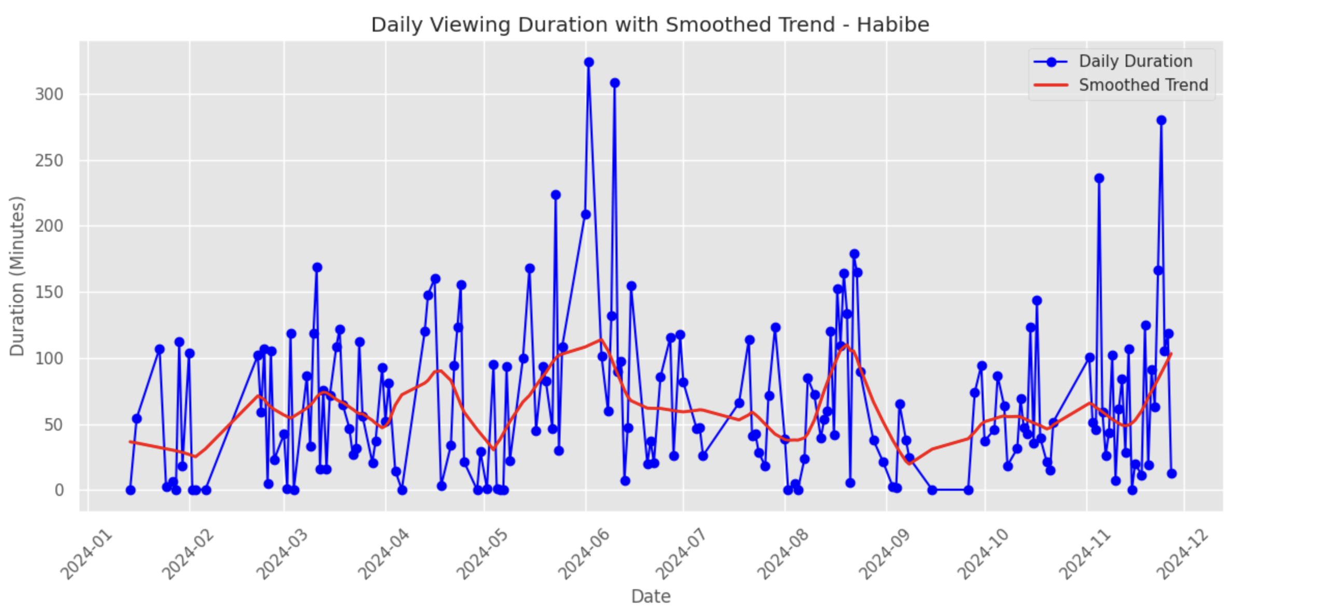
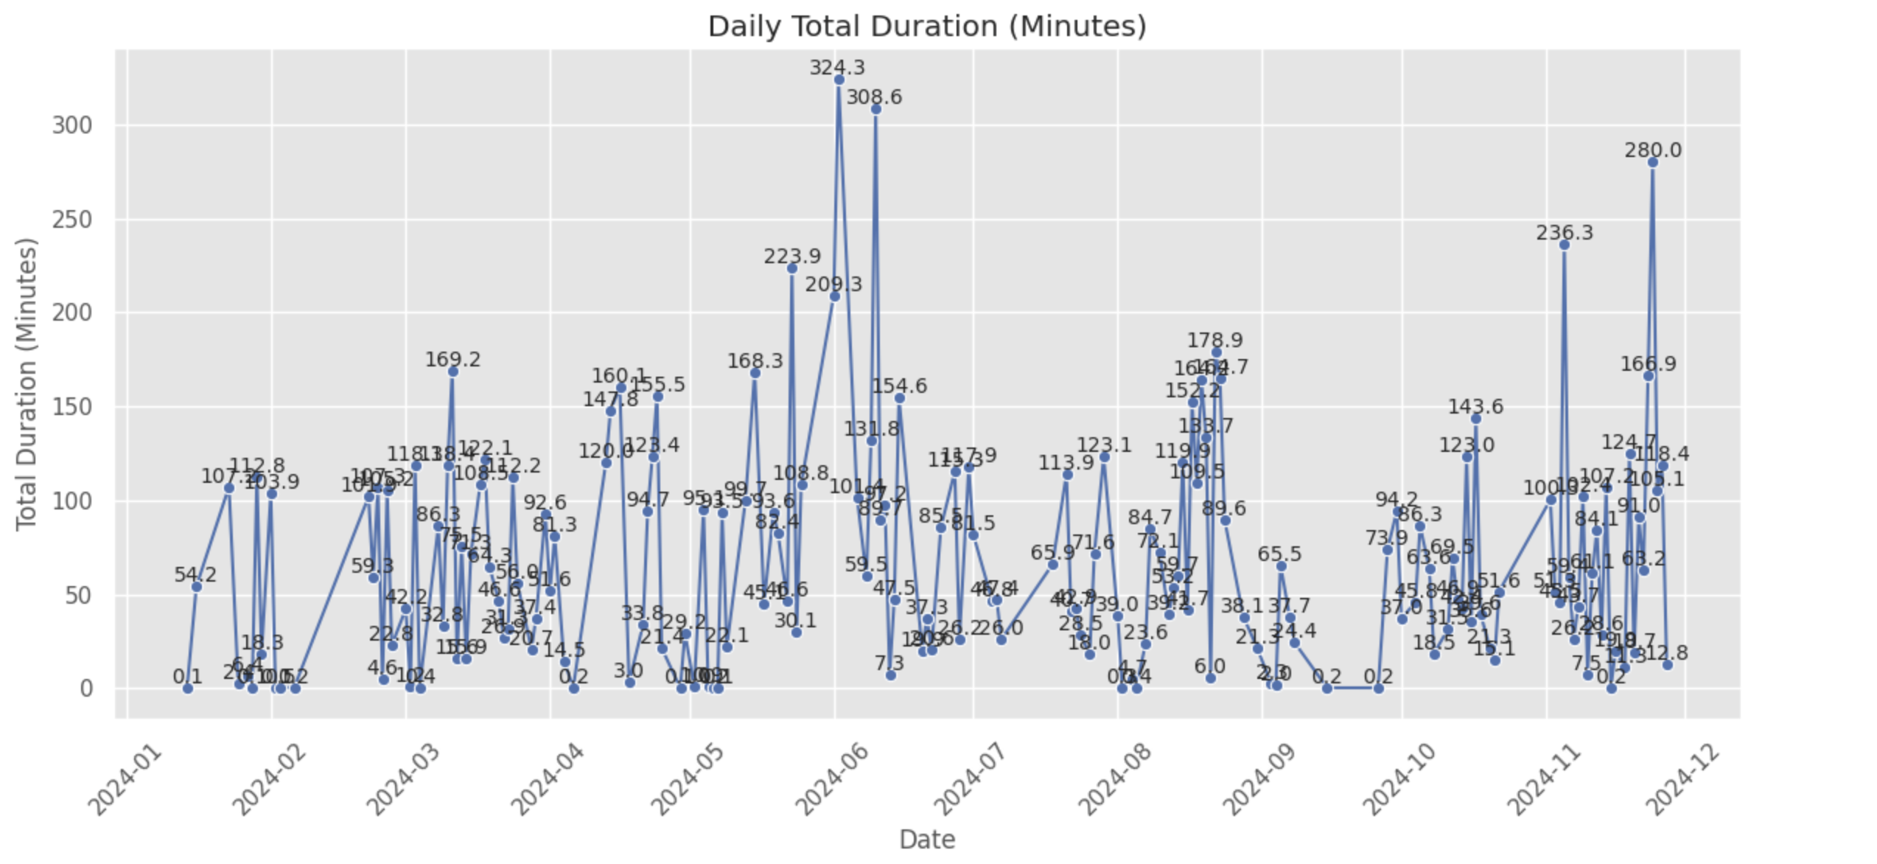
This graph shows the smooted trend.
Here we can see the extreme values.

Slide 9
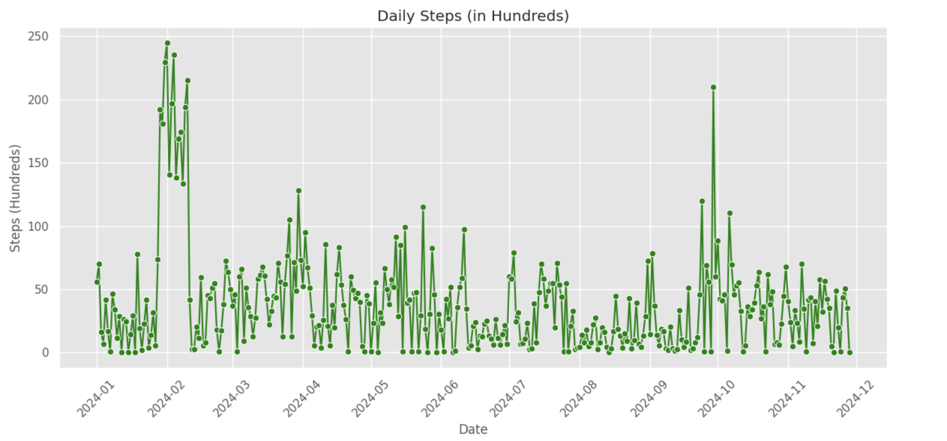
For the step counts, first I eliminated the unnecessary information from raw health data. Then I started to explore data by using firstly lineplot.

Slide 10
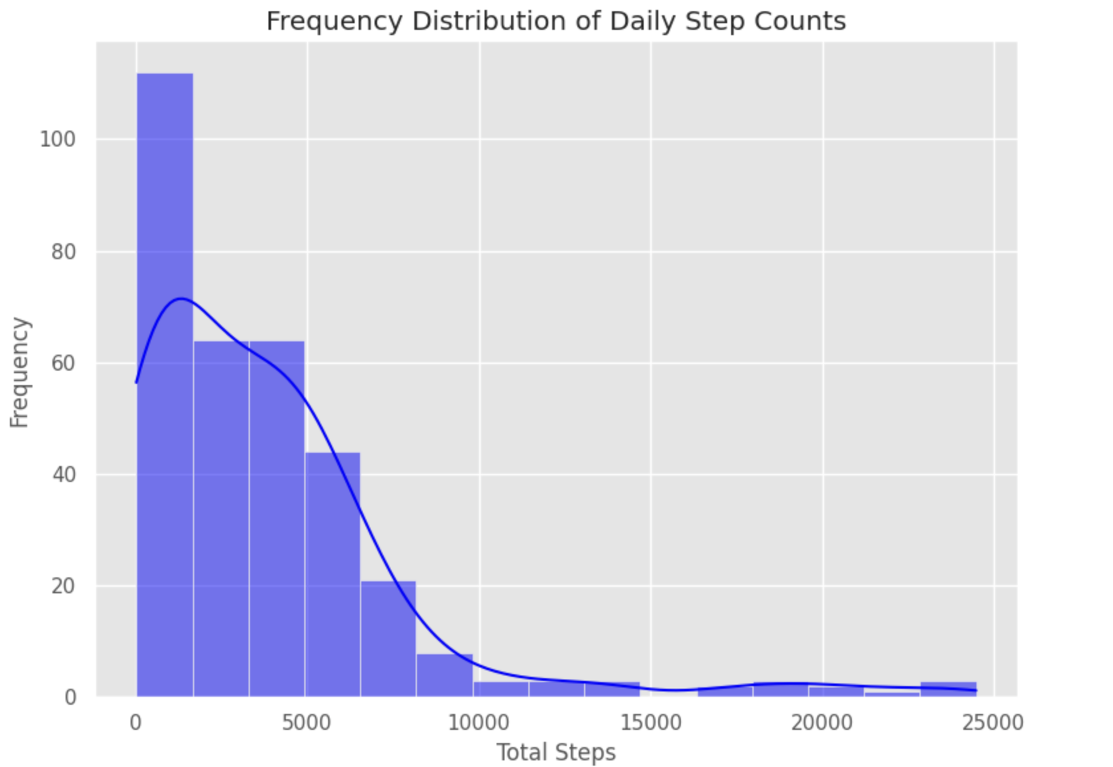
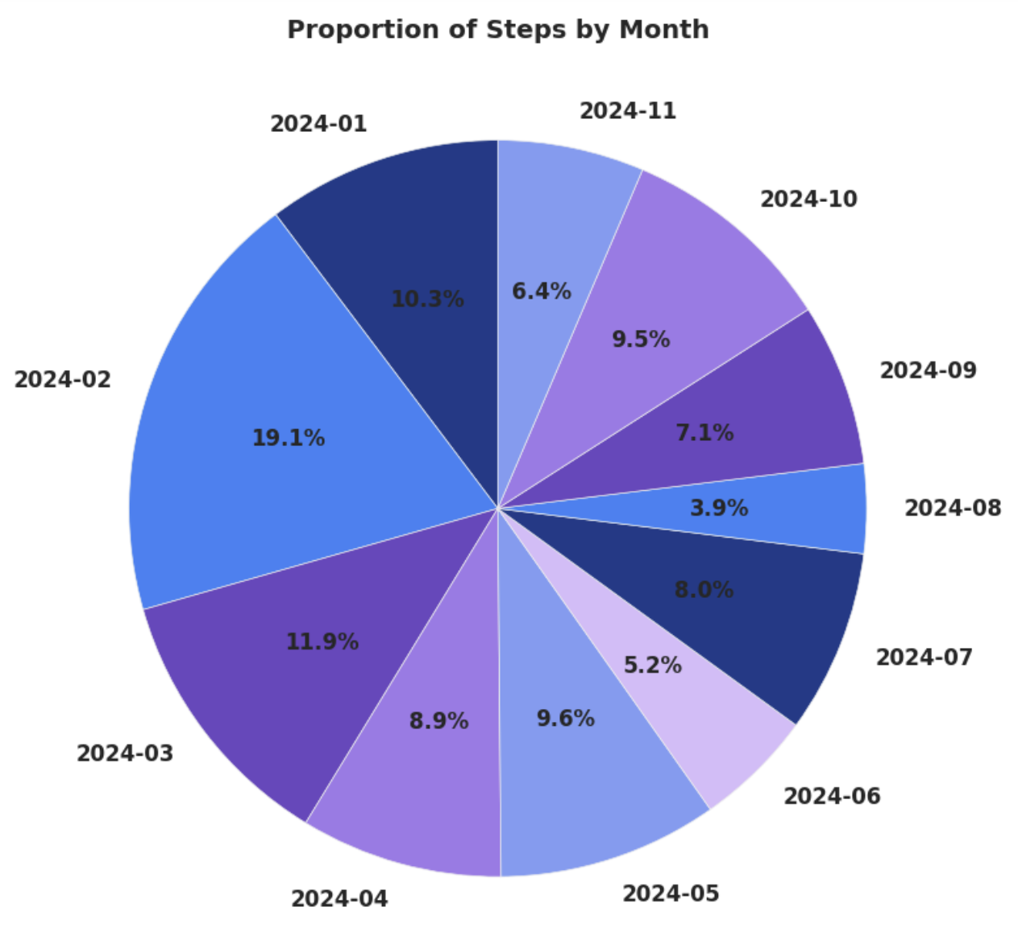
This pie chart shows the proportion of total step counts by month.
Here we have frequency of daily step counts.

Slide 11
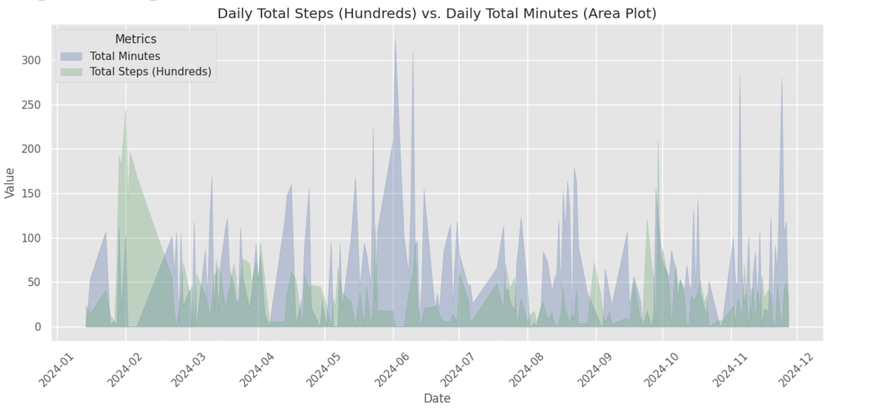
Then I analyzed data to see the ralation between daily step counts and viewing activity by showing them in one plot.
When of the variables has zero value data of that day is eliminated to proper calculation of correlation.

Slide 12
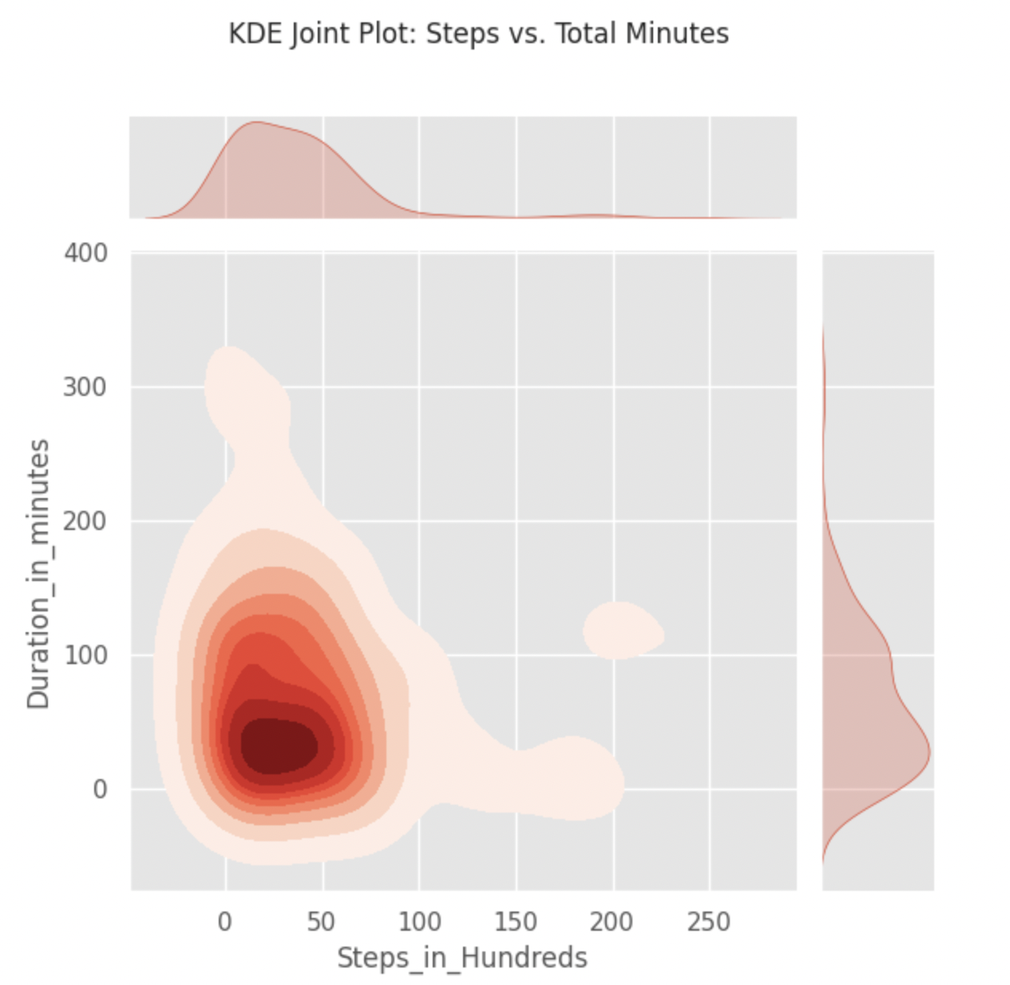
Here we can see some other visualization examples for better understanding of correlation.

Slide 13
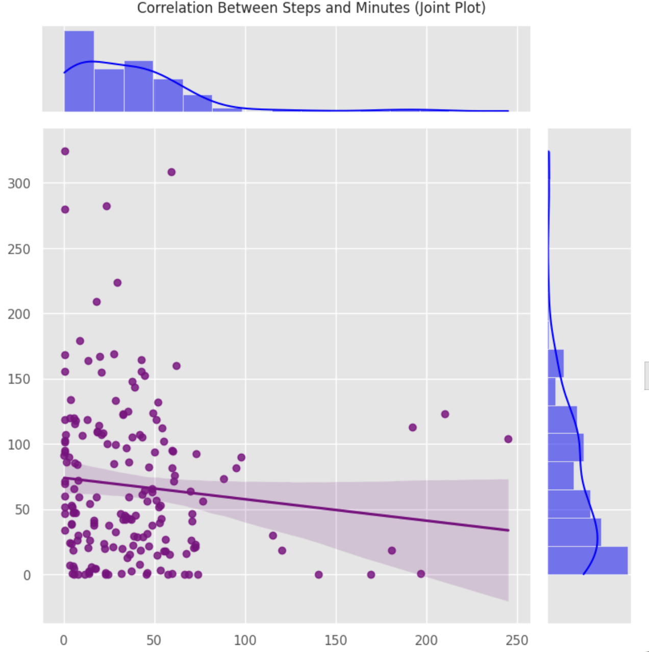
It looks like there is a negative correlation between step counts and screen view activity.

Slide 14
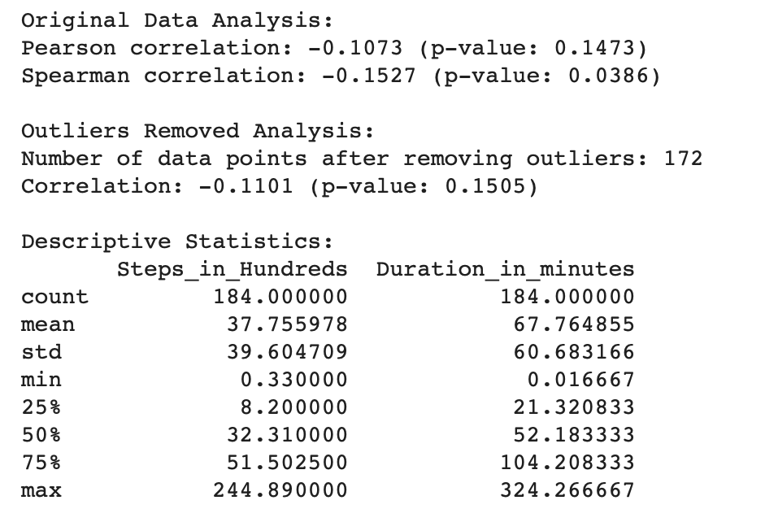
However in order to reject/fail to reject the null hypothesis we need to do further analysis by identifying the correlation coefficient and p-value.
Because of the nonlinear relationship of variables, I used Spearman correlation to identify the correlation between the variables.

Slide 15
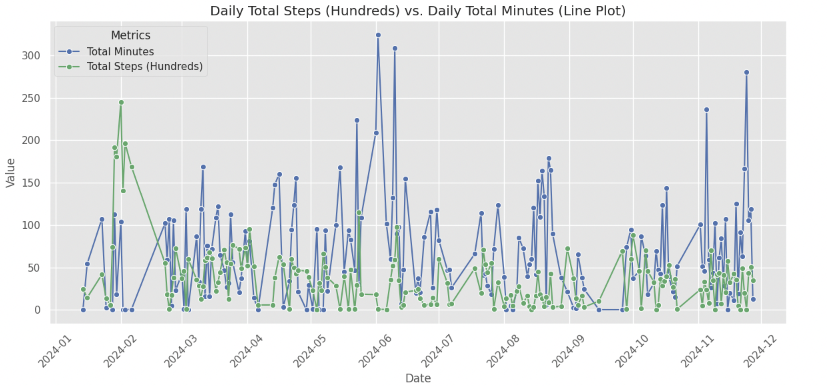
I found Spearman correlation as: -0.1527 (p-value: 0.0386)
It suggests that there is a weak negative correlation between the variables, and the relationship is statistically significant because the p-value is less than 0.05.
This indicates that there is likely some degree of monotonic relationship between the variables.

Slide 16
Then, we can reject the null hypothesis which is:
‘‘ There is no correlation between my netflix activity and my daily step counts.’’
Habibe Köseoğlu

